Slide 1
IMAGE CLASSIFIATION USING CNN
Final Project
Presented By:
Archana M
B.E. computer Science and Engineering
Email: archanakarungal@gmail.com
NM id: au962821104011
University College of Engineering Nagercoil

Slide 2
PROJECT TITLE
IMAGE CLASSIFICATION USING CNN

Slide 3


AGENDA
Problem Statement
Project Overview
Who are the end users?
Our Solution and its value proposition
The wow in the Solution
Modelling
Results
Conclusion
3/21/2024 Annual Review

Slide 4

PROBLEM STATEMENT
Developing an image classifying system using Convolutional Neural Network to categorize images accurately from the CIFAR-10 dataset.
The goal is to train a CNN model capable of recognizing and classifying objects within images with high accuracy.
The model is trained using normalized pixel values and one-hot encoded labels.
After training, visualize sample images from the test set along with their true labels and predicted labels to evaluate the model's performance.

Slide 5

PROJECT OVERVIEW
Our project aims to develop an image classification system using Convolutional Neural Networks (CNNs) to accurately categorize images into predefined classes.
We'll train the CNN model on a dataset containing labeled images, such as CIFAR-10, and fine-tune it to achieve optimal performance.
Once trained, the model will be deployed for real-world applications, providing accurate image recognition capabilities across various domains.

Slide 6

WHO ARE THE END USERS?
Researchers
Developers
Business
Government Agencies
Industry Professionals
Educators and Students

Slide 7

OUR SOLUTION AND ITS VALUE PROPOSITION
Our solution, an image classification system powered by Convolutional Neural Networks (CNNs), offers unparalleled accuracy and efficiency in recognizing and categorizing images.
By leveraging advanced deep learning techniques, our system provides reliable and scalable image recognition capabilities across diverse domains.
Its value proposition lies in its ability to streamline workflows, save time and resources, and drive innovation by automating image classification tasks with high precision and versatility.

Slide 8

THE WOW IN THE SOLUTION
Our solution utilizes advanced Convolutional Neural Networks (CNNs) to achieve incredibly precise image recognition, surpassing human-level performance in many instances.
It effortlessly adapts to handle large amounts of visual data across various industries.
Its automation saves time and resources, driving innovation in image-related tasks.
8

Slide 9
MODELLING
Architecture Design: We create the blueprint of the CNN, deciding on the number and types of layers it will have, such as convolutional, pooling, and fully connected layers.
Layer Configuration: Each layer's parameters, like filter size and activation functions, are set to extract relevant features from the images.
Training Setup: We define how the model will learn from the data, including the optimization algorithm, loss function, and metrics to monitor its performance.
9

Slide 10
Data Preparation: Before training, we preprocess the images to ensure they're in a format the model can understand, which might involve resizing or normalization. Training: We feed the preprocessed images into the model and iteratively adjust its parameters to minimize the difference between predicted and actual labels. Validation and Tuning: We assess the model's performance on a validation dataset and fine-tune its hyperparameters to optimize its accuracy. Evaluation: Finally, we test the trained model on a separate test dataset to evaluate its performance and ensure it generalizes well to new, unseen images.

Slide 11
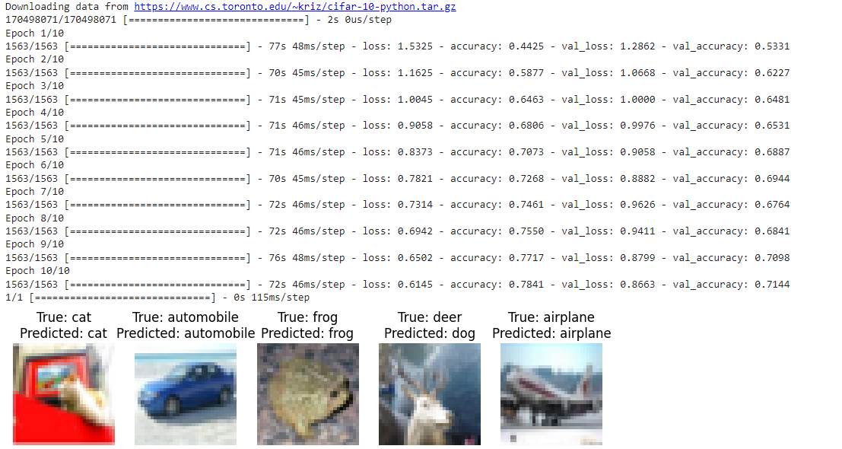
RESULTS
11

Slide 12
CONCLUSION
Thus, the project successfully created an accurate CNN model for CIFAR-10 image classification using TensorFlow/ Keras.
Through meticulous data preprocessing, model training, and evaluation, we've developed a robust system capable of recognizing patterns and features in images with remarkable accuracy.

